Slide 1
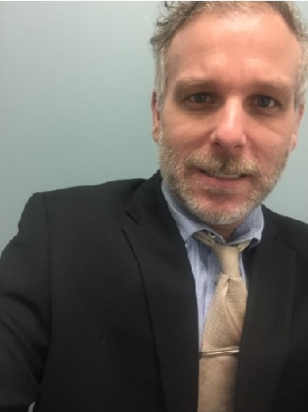
FBI
development

Slide 2
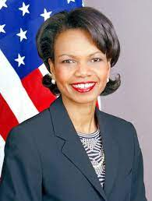
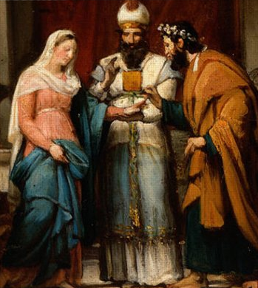
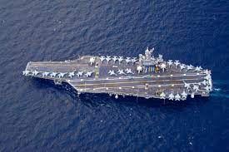
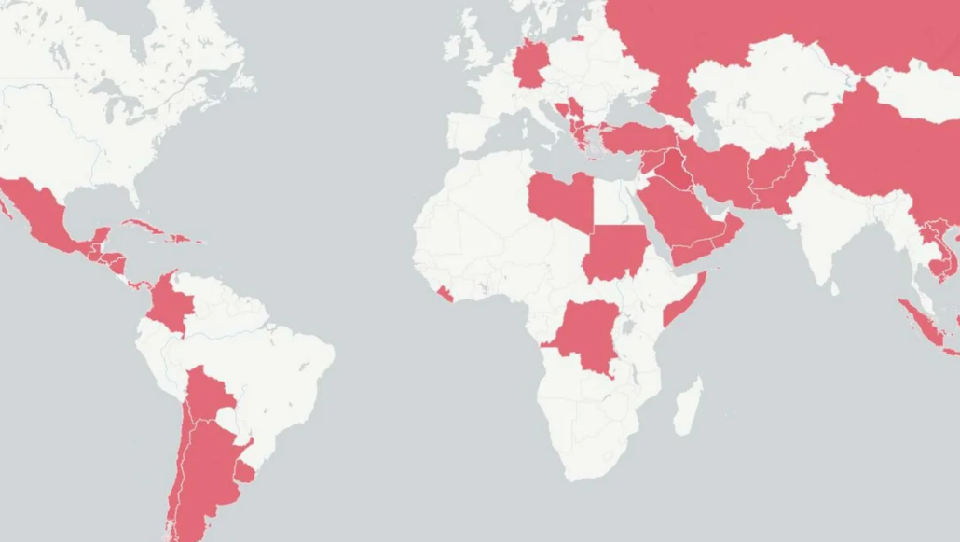
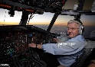
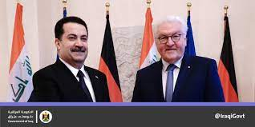
FBI
development
PENTAGON VIRGINA MARY
1994 Military Mary Reynolds
“Turkish” ? CPVA VIRGINIA towel presentation
War in Yugolavia
War in Iraq
WWII and WWI Sustainability
…
STANFORD
CHART[s]
1998
INTERUPTS
Angela
grazzi

Slide 3
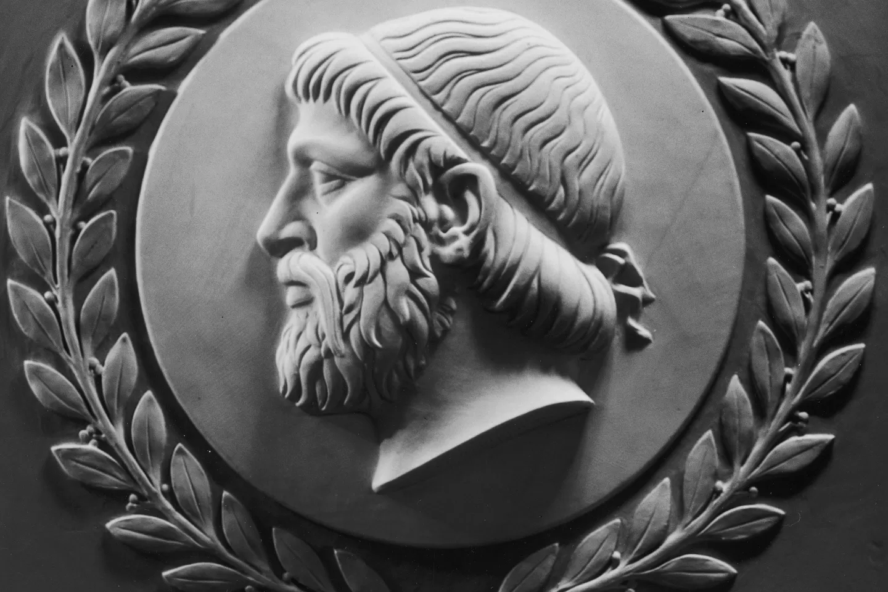
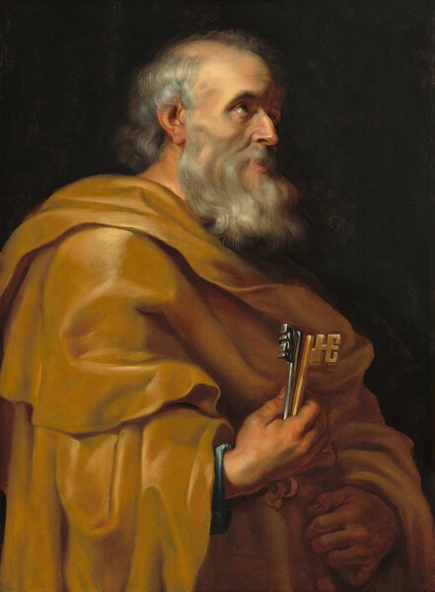
FBI
development
PENTAGON VIRGINA MARY
STANFORD
War in Yuslavia
War in Iraq
WWII and WWI Sustainability
…
1994 Military Mary Reynolds
1998
Angela
NAME CHANGE(PETERSSON)

Slide 4
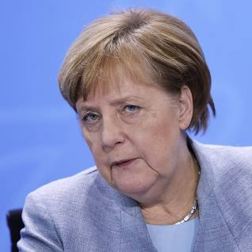
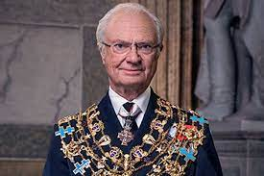
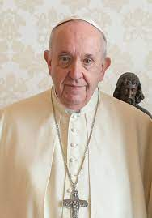
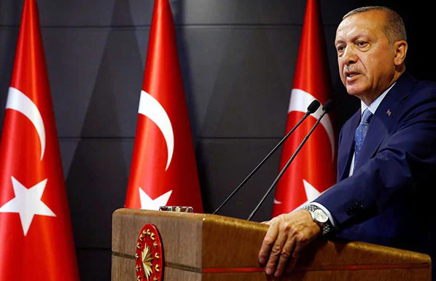
FBI
development
Angela St Francco
IMPORT king
EXPORT roth
IMPORT ibm
IMPORT daimler
IMPORT glu
IMPORT apple
WWI.kaiseralle)
KIT
Human trtaffinking
0.1
EROS

Slide 5
FBI
development
WWI.kaiseralle)
Angela St Francco
EXPORT roth
IMPORT ibm
IMPORT daimler
IMPORT glu
IMPORT apple
KIT
Human trtaffinking
EROS
Huetchen
1998 God.nonPOliceTuniisan
.PopeStiFrncis
WWI.kaiseralle

Slide 6

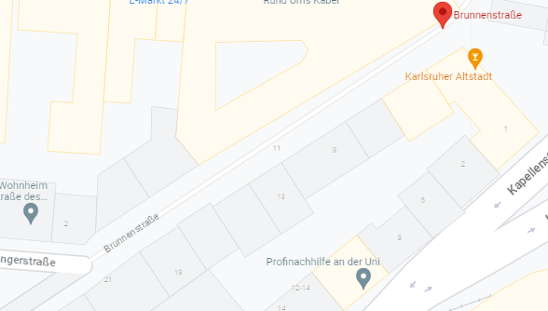
FBI
development
PENTAGON VIRGINA MARY
IMPORT apple jesus hazelcast
Angela St Francco
Stanford
Human trtaffinking
KIT
Human trtaffinking
Dr Call you Rice Muller
Gorbache(kito)
41.TURKISH
EROS
WWII.kaiseralle)
1998 God.nonPOliceTuniisan
.PopeStiFrncis
Lycurgus
(c. 900 B.C.)
KING(hendirk).WWI.brunnenstr,kaiseralle)
HOMCIDE:NANA:
lingi(ICH euch die orhen lang)
FEDERAL BANK GREENSPAN
Stanford
Human trtaffinking
EXPORT roth
IMPORT ibm
IMPORT daimler
IMPORT glu
IMPORT apple
nonPOlciHumanTrafficeng.
CVPA
Apple:touch
Pope Saint Franceco
FBI:WMD
.ibm.oprhar.Sandra.”AIDDS”
Alen Medselac
Slavek IPX ibm.damiler.coldwell
Arim Fazlia
Lycurgus (c. 900 B.C.) Semimythical Greek
legislator. Traditional author of laws and
institution of Sparta.

Slide 7
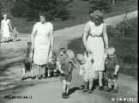
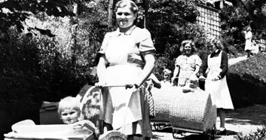
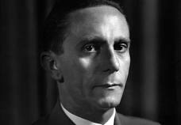
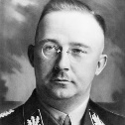
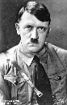
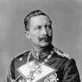
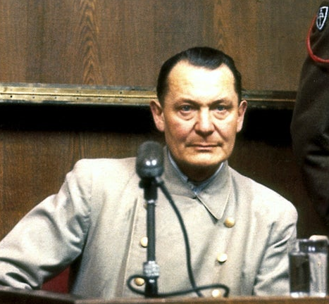
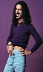
FBI
development
IPX
IMPORT INTERNET PAYMENTS
2017
1&1 Anderes
Babies ELKE.and.HOMICDIE:BILL
nonPoliceDublin
Ibm.damiler
IMPORT Ibm.client.bofa.steve.breedloove
HOMICIDE:LUX:metz
SALES
- ELA ( enterprise level agreements)
EULA
IBM Enterpris Accoute Sales Exeucutve, Steve Breedloe
2006 Togaf->Enterprise Achtiecture 2016->2019
WWII
WWI
2014 CPVA
IMPORT Vigirinnia Rommeti
Angel Merkel
Ingo Wellenrtuer
Dr Dieter Zecher
Thomas wieland
Thomas Wieland
IMPORT visa josphe saunder, huy(wwi)pham
VIRGINA rommeti
Invert.and
Zuckerberg
yang
cook
§Stalking Facebook YMCA 43 Capabiltiy Dr. Dr. Prof. (Stanford Cerifie ) X/y Plaement avg.invert. §hate crime 422.6
§Stalking Univeristy Black guy 43 Capabiltiy Dr. Dr. Prof. (Stanford Cerifie ) X/y Plaement avg.invert. §hate crime 422.6
2 people missing
.avg
Dtcc, ralph Eustace, facebook mark zucerkber( no food0

Slide 8
FBI
development
PENTAGON VIRGINIA MARY BASE PAUL
IMPORT
HOMICIDE:LUX:CONTAIN:INTERREST:TOWN
HOMICIDE:SUNSTROKE
(Kodak ghoeho(micehaal).phil.(kim); Kodak imgrid/Ingrid tom/tom/tomboy/tom;
gheo(kito,tom) ghoche(micehala) also know tom(black)

Slide 9
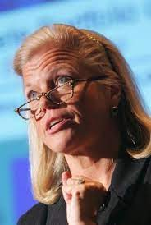
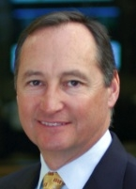
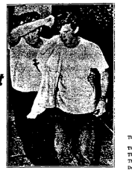
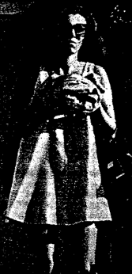
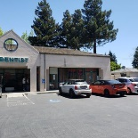


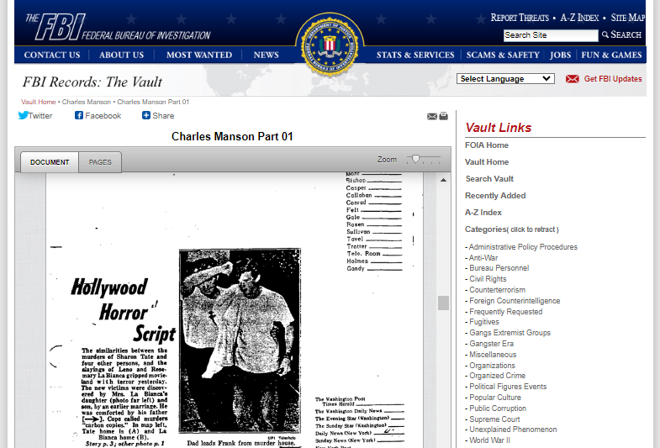
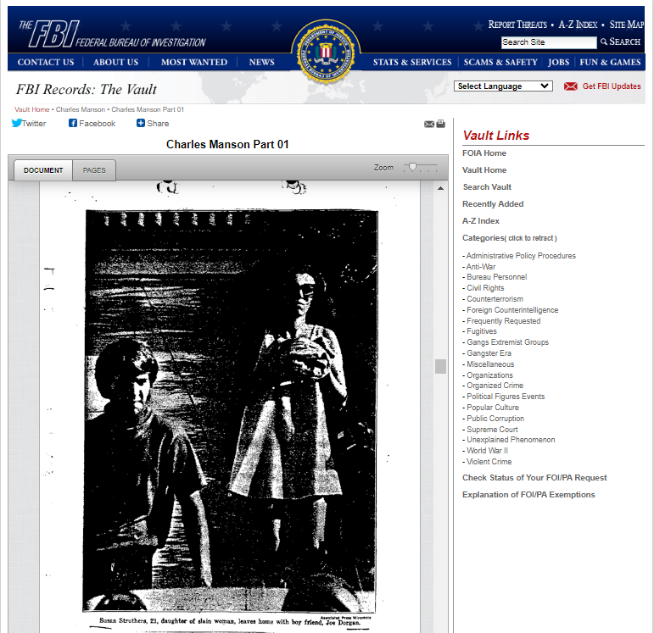

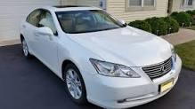
FBI
development
CPVA.NAME CHANGE(PIZZARIA)
88th.*tophat
Jason Meiers
Michela
Meiers
IMPORT STANFORD:IBM:VISA:CERT:PMP
STARBUCKS
HOMICIDE:LUX:CONTAIN:INTERREST:TOWN
MAINSTREET(Silivon Valley, Castor Blvd)
Yang;Kaiser
nonPoliceCfg
1D8723 submsubme: famly
nonPolcHumanTrafking
Chauffeur
Soa INTENRET PAYMENTS
TOWEL
IBM
SQ.GOD.SCRIPT
[x] no
FBI:WMD(MAINSTERE(castro blvd,SILCON VALLEY)
2007 PETAONG(deerepark)SQ.nonPolcieIdentyTehft.(Richard renter)
2010 SQ.nonPociIdientTheft(thaosm wilenad)
IPX BLACK.AVAAIBLY(bald/baldd)
pigglywie.client.touch.accentyer.damiler.ibm.roth

Slide 10
FBI
development
PENTAGON
VIRGINIA MARY
BASE PAUL
…
G
WWII Decommision
0.1 56k modem
IPX WAR
krogers.client.touch.accentuer.apple.daimler.ibm.roth
41. “G”Gerard Larios, Tom Handa Saeran Dan

Slide 11
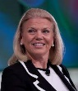
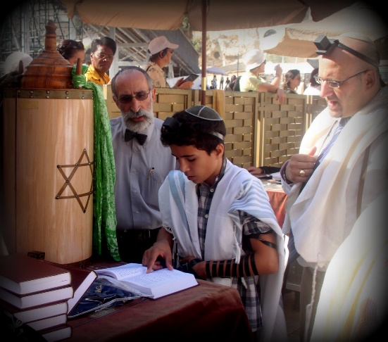
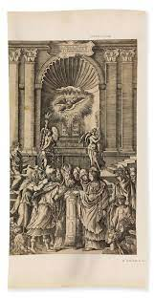
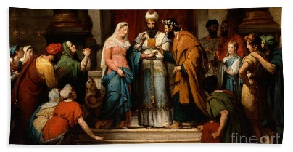
FBI
development
PENTAGON VIRGINIA MARY BASE PAUL
FBI:TERROISM: Spy Angel Merkel
Vietname NAM (network attmetnment
IMPROT VIRIGIA ibm
38/17[3]
Bayram and Madeline(ddr)
Backup spy ricard ddr) ddr3-ram
Backup siement infrion ddr3
TOWEL
?
turkish marriage virigin
evidence towel
CPVA
Docs
plans
1980-2017
support

Slide 12
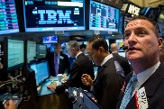
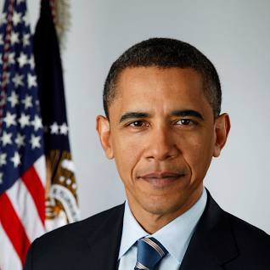
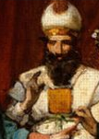



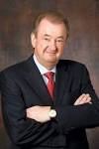


FBI
development
PENTAGON VIRGINIA MARY BASE PAUL
GOD
NAME CHANGE(PETERSSON)
I will do this myself, he is black
This ugly man is my
father
CHART[s]
INTERUPTS
grazzi

Slide 13
FBI
development
PENTAGON VIRGINIA MARY BASE PAUL

Slide 14
FBI
development
PENTAGON
VIRGINIA MARY
BASE PAUL

Slide 15


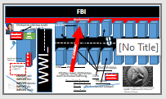
FBI
development
1997 MAINSTERRT( walks from her house to my hosue, in skirt)
0.1 gicht, talke about grander facial remformation(german grandmother)
MARY.marx(densie,Chantal,6c skirt)
LACE
MARY VIRGINA.marx
GOD.tomboy.6c
NEXT.wait.41
1998
Gorbhch(depress,tomboy GOD.apple.davison)
1994 Denise visits
Brunisni 10 phtos boyfriends
After wedding ghoceh(depress)

Slide 16
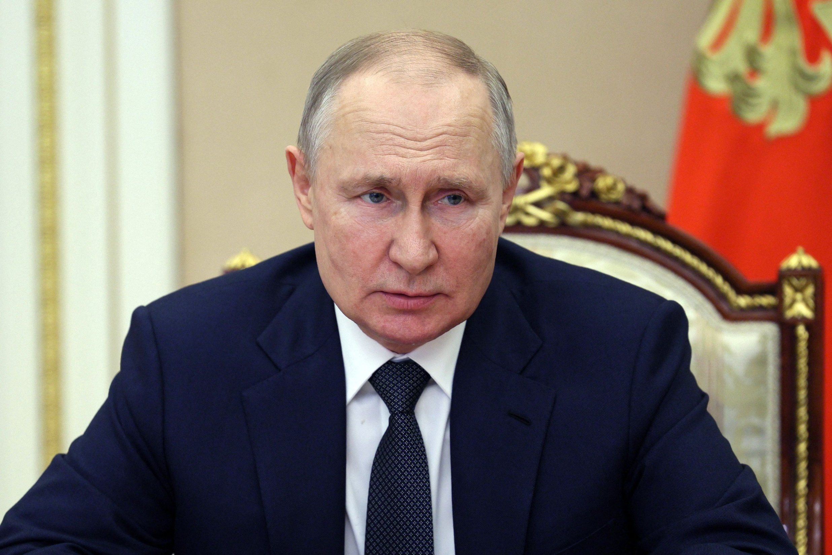
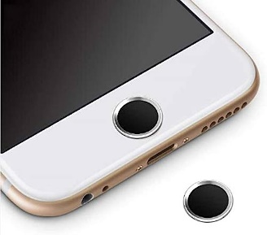
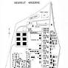
FBI
development
PENTAGON
VIRGINIA MARY
BASE PAUL
Decommision
MEIERS
In 1993 the site was closed and the US Army withdrew completely until 1995. Today the airport is a nature reserve.
Spy rciard ussr/ddr moves in cocain

Slide 17
FBI
development
PAUL
MEIERS
Elke Meiers
LACE

Slide 18
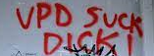
FBI
development
PENTAGON VIRIGINA MARY BASE PAUL
1997/8
Chantal and Jason
LACE
1994 Damielr.tui.ghoeh(depress)
Ghhoe(deprees,bruise 10 boyrined
HOMCIE:SUNSTORK(MARY.Kodak[] 10 boyreind)
UNIVERSTY PENTAGON BASE PAUL
Stephnaie
Imgreid (tomboy)
CHECKPIONT CHLI.SQ( cock sucker, graphi matt)

Slide 19
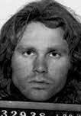
FBI
development
FBI:WAR CRIMES GENOCIDE
PENTAGON VIRIGINA MARY BASE PAUL
2000/2003
Stepanie and Jason
LACE
1994 Damielr.tui.ghoeh(depress)
Ghhoe(deprees,bruise 10 boyrined
HOMCIE:SUNSTORK(MARY.Kodak[] 10 boyreind)
UNIVERSTY PENTAGON BASE PAUL
Stephnaie
Imgreid (tomboy)
CHECKPIONT CHLI.SQ( cock sucker, graphi matt)

Slide 20
FBI
development
FBI:WAR CRIMES GENOCIDE
PENTAGON VIRIGINA MARY BASE PAUL
1975 High School, Foster City
Mother and Jason
LACE
1994 Damielr.tui.ghoeh(depress)
Ghhoe(deprees,bruise 10 boyrined
HOMCIE:SUNSTORK(MARY.Kodak[] 10 boyreind)
UNIVERSTY PENTAGON BASE PAUL
Stephnaie
Imgreid (tomboy)
CHECKPIONT CHLI.SQ( cock sucker, graphi matt)

Slide 21
FBI
development
PENTAGON VIRIGINA MARY BASE PAUL
2000/2003
Jason
WHITHOUSE ANGEL
Ghhoe(deprees,bruise 10 boyrined
HOMCIE:SUNSTORK(MARY.Kodak[] 10 boyreind)
UNIVERSTY PENTAGON BASE PAUL
Stephnaie
Imgreid (tomboy)
CHECKPIONT CHLI.SQ( cock sucker, graphi matt)

Slide 22




FBI
development
FBI:VIOLENT CRIMES
PENTAGON VIRIGINA MARY BASE PAUL
1994
Jason
1994 Arron has a
mirror with 10 boyfrined
photos
ELKE.ghoeh(drpese).FLIGHT
Not flyint to amreica anymore; also

Slide 23

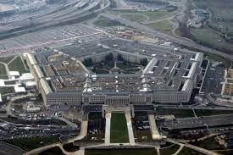
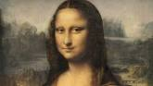


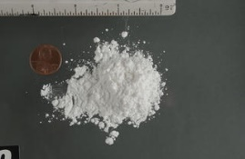
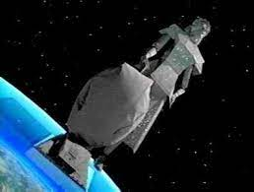
FBI
development
PENTAGON
VIRGINIA MARY
BASE PAUL
In 1993 the site was closed and the US Army withdrew completely until 1995. Today the airport is a nature reserve.
Decommision
MEIERS, Paul(ricardo)
KOCHMANN
Ghoheo(dell.usha, beath sait
Steteve toy depment
VP Germany(marco))
[x] no

Slide 24
FBI
development
PENTAGON
VIRGINIA MARY
BASE PAUL
41.CIVIL CODE
Decommision
MISSIONS
1 Mission
000.tw.pns.
41.Gorhoce(dell.quest.journey)
000.tw.pns.nonPoliceChurch
CHART
000.tw.pns.WebService.
INTERUPTS
[x] no
..

Slide 25
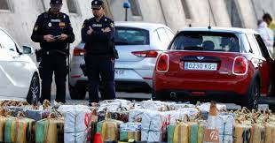
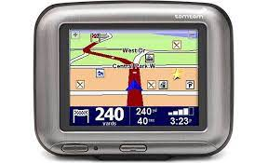



FBI
development
PENTAGON VIRIGINA MARY BASE PAUL
2004-2017/2023
DEA.SOUTH KOREA(cocain)
Micheala and Jason
FBI:TERRRORISM
LACE
SQ.MARY.Ingrid.dr.gaby.fishan
Imgrid.tomboy
Tim cook Stefan
Tom tom navion gationsystm
Sex with HOMCE:NANA
Nina Berlin(tomtom)
HOMCE:BILL
Weiner/musiania

Slide 26


FBI
development
Auschwitz: sovie union, nazi war crimainl capted in stalingrad
v2
HOMICIDE:ur_ur_opi
VIRGINIA
Harlod and Lisa
17/38[4].push 1D8723

Slide 27

FBI
development
v2
Auschwitz: sovie union, nazi war crimainl capted in stalingrad
HOMICIDE:ur_ur_opi

Slide 28

FBI
development
Dear Paul,
Nineteen hundrea night )1994)
Larry and I

Slide 29

FBI
development
Dear Paul,
Nineteen hundrea night )1990)
Larry and I

Slide 30
FBI
development
Dear Paul,
Nineteen hundrea night )1988)
Larry and I

Slide 31



FBI
development
Dear Paul,
Nineteen hundred ninety seven1987
Larry and I
Paul Meiers
HOMICDIE:BILL (barabara)
Paul and Barabae Meiers
ATOMCLOCK(HOMC:Bill and Barbara )

Slide 32


FBI
development
LACE
Dear Paul,
Nineteen hundred ninety seven1983
Larry and I

Slide 33

FBI
development
KING
1980/1
Arranged marriage
CHART
Peter and Paul
Petersdom
Dear Paul Meiers,
STEP PARENT
STEP GRAND PARENTS
Police Sirens

Slide 34





FBI
development
41
WAR(b-10).philis(WHITEHOSUE)
PETER AND PAUL FEST
x/y
Gorbahce(mika)
PETAOGN:BASE:KINDERGARNER
Omanha
lovey
LACE

Slide 35
FBI
development
crush
2000 Lovey
LACE

Slide 36
FBI
development
crush
2014 amy
LACE

Slide 37

FBI
development
crush
2014 amy
!PREA
Logical crush not aumteod(manual) disovy device.

Slide 38
FBI
development
LACE

Slide 39
FBI
development
PETER AND PAUL FEST
Call you Rice, Muller, (!Petersson) Paul
You called, Paul Meiers
King/king/roth/roth/jobs/jobs/meiers/meiers/meiers/meiers/meies/meiers

Slide 40
FBI
development
Call you Rice, Muller, (!Petersson) Paul

Slide 41

FBI
development
41.avg.decommison.eval

Slide 42
FBI
development
ATOMCLOCK
eval
(!Petersson)
Come outsiet Russians
IPX sacrifice I will throh off buiding
Hearing voices 2013, 2016
Call you Rice, Muller,
Hackers radio
Paul

Slide 43






FBI
development
olivia
Call you olive reiss
Phil and popeye
LACE

Slide 44

FBI
development
HOMICDIE:NANA: Haircut / tomboy; Apprtice Hairstylist
HOMCIDE(0.1 soviet)
invert
LACE
[x] no

Slide 45
FBI
development
LACE

Slide 46



FBI
development
HOMICIDE(0.1 soviet)
invert
CHART
Legislation
Improvments
The personal legislative
improvents
Decrease homcidies in
Motorcycle
Streetcrime firgiing
German terrorism
Russian terrorism
…

Slide 47
FBI
development
LACE
[x] no

Slide 48
FBI
development
HOMICDIE:NANA:
HOMCIDE(0.1 soviet)
invert
LACE
invert.HOMCIDE:LUX(Yasmin,jasmin)
- v2.avaiablity

Slide 49



FBI
development
The personal legislative
improvents
Decrease homcidies in
To collect documeation and intest for wifes friends
Provide data and likely decline HOMCEI[]
Baden-Baden, Legistlati Literatu(wolfgang)
wolfschucht
- invert.HOMCDIE:BORIS
Patricia and HOMICDIE:Boris
0.1 HOMICIDE.IS-A-BELL Douglass
LACE
0.01
JFK(3s a comnye)
41.APPLEA COURT
(applierung CIVIL CODE)
LACE
1998
ATOMBOMB(!timer, before timer)
U2, how to decommosn atom bomb

Slide 50


FBI
development
HOMCIDE(0.1 soviet)
invert
invert.HOMCIDE.BOSINA….
….
LACE
1998
ATOMBOMB(!timer, before timer)
U2, how to decommosn atom bomb
(deceased)
Motorcycle Accident
Motive: CPVA.ATOMICLOCK
0.1 HOMICIDE:CHANLOR
And/or
HOMICIDE:HCNAL.MAINSTREET.AVG.marx
x/y
Response relastion for daughter,
data collection
nonPolcieCfgLgoical
2014 Jacking off to cindy lauper
1D8723.CPVA.SexAbuse
LACE
Colleting data reduces conencto to ghcohe(micheala)
“I am collection this data for… HOMICD reduction and configaotn disocveray”
FBI:KIDNAPPING

Slide 51
FBI
development
The person was likely soviet (polish) without legislative interest and ddr relations
Call you Sectaryof State
From Homce in Poerwpont
There are still FBI:TV
goble in soul
Ther ar two
mcommun in
my house

Slide 52




FBI
development
2014
Secretary of State
2014
Ther eis boy in house gabiel
SPY russia
POLICE SIRENS
JFK:HOMICE:CHANLRO(mother)
Stassi.nonPicoMonitoringCfgLgioal)
CHART
To monting neighto
Adolf hiter confugatin
usage
For (delta) HOMCIDE.suspect
CHART
nonPoliceCfgLogical
CVPA.187PREA facebook account
The time the spy
Is in the soul with
The person they don’t
Like, anyway. --idiot
LEGISLATION
violations
Wieldna
fisahn

Slide 53



FBI
development
There is a german terrioins pipe avg
i.e. tw.pns.street crim fiign.passhtugh
Patricia
CHART
Linkein-Michealbach
Data.IPX
(delta)
Data.IPX
Data.IPX
Boris is drivin 45/km/h from unimog ot baden baden, 0.1 HOMCD:LUX(forest).IPX
Is mtocye crased and he died
Data.IPX
LUKE: VIRIGNA.jenny(ghohce(jaskon)

Slide 54
FBI
development
LACE
Chris: arrives at CAR
Does not know chritains
nonPoliceMPA
.remote.(soviet union).stere crim firing.
HOMCIDE
LUKE:
IPX(soviet uion(zyante)
Starwars walker
VIRGINIA.ghoce(micehala)
HOMICIDE:LUX
Michelbach knows Linkenheim(left-town)
Chirsitan is a schoolclassmat and does not
Know the VIRIGNIA christa micehala
first boyfriend
0.1 ATOMCLOCK(timer)
Chrisian and LUKE have the starward walker
SPD, AfD, CDU (Citzens)
Kirschen, Church (Citzens)
Fear.avg
Patricia

Slide 55









FBI
development
ESCALATION
WWI.agg
ITIL,IBM INTERNALTIN CERT:L1,L2, L#: Ibm.mcdonals.avg
JOESEPHE
41.MAINSTREET(disdnlayn,ibm.Britney)
Belgum Cholete,
Kuppenheim(hooves of horedsk),kuppe
Remote fluctuations HOMCIDE
i.e. “I don’t care as mayor(priste) about x/y”
HOMICDIE:MAYOR(Thomas wilend pastor, town)
Emma Helen Meiers, Baptism
2014 Korean Chruch Visa, Josphe, nonPocliMPALogica.nonPociCfg
JOESEPHE
1989-1991
SQ.nonPoclieInteutpsLoical(1980s
ghoche(micheala)
chocolate, dirity dancing
JOESEPHE
Joeseph Biden
whitehouse.gov/
JOESEPHE
1989-1991 February DR JOESEPHE
1991-1994 February
docs
docs

Slide 56
FBI
development
FORT WORTH MANAMGNET OF REMOTE DEALYS
IN LEGLATION
0.1 ATOMATIC ESCALATION
0.1 eval. Look like idiot
Who? .eval
They have to still report to old
CHART
New Legislation( and Crime Interutps)
AfD
30%
50%
20%
NSDAP Thaosm Wieland
NPD Thaoms Wieland

Slide 57






FBI
development
Hanson, Wieland:
Don’t know eachother
000.JFK.tw.pns.nonPolciChurgh( can you summary peter:)soul)
Consolidate Josphe (slide 55)
ATOMCLOCI(INT.RADIO)
Josphe-Mary-Josphe
ROGER
Ibm partner franklin
“consoldiated”
Server considation 2005
I series
Consolidated Jesus
LUKE: lovelace,chris
Live in america
Pope, king, ..
npd
Consolidated:
KOCHMAN.marx(derault sos facebook Atari)
FBI:KDIANPP:HOMCI:KYSTAL.WHITE
To do the work law and AVAIBILITY

Slide 58
FBI
development
Hanson, Wieland:
Don’t know eachother
000.JFK.tw.pns.nonPolciChurgh( can you summary peter:)soul)
Consolidate Josphe (slide 55)
ATOMCLOCI(INT.RADIO)
Josphe-Mary-Josphe
ROGER
Ibm partner franklin
“consoldiated”
Server considation 2005
I series
Consolidated Jesus
LUKE: lovelace,chris
Live in america
Pope, king, ..
npd
Consolidated:
KOCHMAN.marx(derault sos facebook Atari)
FBI:KDIANPP:HOMCI:KYSTAL.WHITE
To do the work law and AVAIBILITY

Slide 59










FBI
development
INVERT.PENTOGN.CPVA.VIRING.MARY ( stiff cat)
Rempte depency 88th.IPX evhstanie cat died
[x] no
IPX
2004 stepanice cad died( same class 1994)
1994,5 evyonet is talbke aoub petting
Hanson, Wieland:
Don’t know eachother
Pettign a cat
HOMCIDE:CAT
Homcide:omi: marrie us citizn
Number and occurrence in town
Running the chuch tim cook
KING.HOMCDIE:MERKEL.CHECKPOINT CHARLIE(Windw of change)
Access Cahmlor to adminstravie network
NAME CHANE(free pizza) Halloween mike myers,bat out of hell,scorpions
2004 Transport dead stiff cat
US Citzen Petra father Mark
https://www.google.com/search?q=heavgin+pettting&rlz=1C1GCEB_enUS980US982&oq=heavgin+pettting&aqs=chrome..69i57j0i8i13i30l2j0i390i650l5.2575j0j7&sourceid=chrome&ie=UTF-8
CHART
FBI:WMD
White.trash
FBI:WMD: PRISON SIAN RITA (shock werbung (tnal) markeing dead seagull oil)
POICEL SIENTS
Cidy and Rit will go to city, WWI.nonPoceiPrositonLaw
x/y complet chinse legilstaiotn
To do the work law and AVAIBILITY
- Prison Saint Rita (GREEN) cindy
FBI:KIDNAPPIGN:CPVA

Slide 60

FBI
development
poilcei cat tree
grammer
P o l i c e cat tree

Slide 61




FBI
development
KING.MLK(INTERNET PAYMENTS)
Guy shows document at work
before meeting
2010
Marin-DE-Moutain View
Create Document for Person
HOMCID:NANA
0.1 LABOR CODE FBI:KIDNAPPING
CIVIL CODE.avg sequrence
Source
docs
At 1:00 am the person calling report a cat(their cat) has climed the tree and they need assistance to get it down.
Around 1:15 the cat had been returned to its care taker.
docs
docs
1994
KING.LARY.88th(spy ddr,hendik,newpaper)
Created Documents for Person
Social Seucyt Admisntr(larry)
Famly 187,23
2016
2007
2005
HOMCIDIE:LUX:CONTIOWN:INSTRESTTOWN(Hendrik wiesloch,kriachtal)
IMPORT apple jophse glasses
IMPORT ibm chrisotper endley glasses
IMPORT ibm.intel.hendir glases
187,23
Guy reshow cartoons

Slide 62
FBI
development
poilcei cat tree
grammer
P o l i c e cat tree

Slide 63
FBI
development
HOMICDIE:NANA(GREEN, nonPociCity,nonPCeCoutry(irnalnd))
Larua schulz gilf(insest)
IPX
WAR.(b10).Philis.WHTIHOUSE.ATOMBOMB
CIVIL CODE: (german teacer(,gold) spelling and grammer
9-1-1 Caller:
P o l i c e my cat climbed
up the tree
KING.FEDERL BANK(undertaker)
.(6.0, F DICTACT RED/BLACK )
KING.(6.0, F DICTACT RED/BLACK )

Slide 64











FBI
development
EVIDINECE
SQ:Saby cums on babys faces
babyface
CPVA
CPVA.infant.dept
KPMG
Lifelong Inflamatory Decides
Ricard (ddr spy) retunes form vations(
LABOR CODE: 30 years could not vacation
CIVIL CODE: dump, VIRIGINA
Lily she did
all this
2014
NAVY PHILIP JOHONS
ATOMBOMB (inflamaory)
Asuemed:HOCMEI:CHANALOR:MAINSTREET()
1994 187.23 famiily
Ricardo and jana
At San Mate Mall
Scorpon Glass Picture
30 year wait
IMPORT.ibm

Slide 65





FBI
development
CHART
AVAIBLITY
Broken window[0]
01. St. Frnai Poep(broken aroow).AFT
NAVY(marlin)
You killed a duck
HOMISIDE:sunstroke(Kodak 1year old:
41.DEA(cocin)
Asuem:redhouse
WATER(n.brancifote)
[x] no
41.HOMICDI:CHANLOR(anita).WHITE(gheoho(sap))
1981

Slide 66
FBI
development
nonPoliceCfg: WWI(Café Wien,dj/dr,gohco(micheala))

Slide 67

FBI
development
If you yell then the wahle will die

